Slide 1

Machine Learning

Slide 2
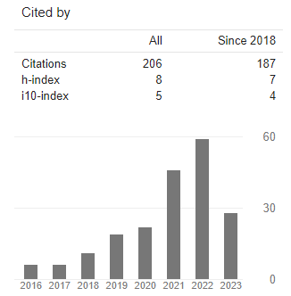
About the Instructor
Dr. Muhammad Safyan
PhD(2018) – AI & Knowledge Graph (Activity Recognition)
Research Output
Number of publications -28
Google Scholar:
Notes:
Widely accepted definition.
Perforamnce is qunatitaive(Scalar , or vector) lets .8 , you get more experience E . You improve your performance let say .85, it mean you learn.
Experience is some thing gain by some entity and you can can direct that entity how to learn. This entity may be any algorithm, robot, software agent.
If b

Slide 3
About the Course
About the Course
Machine Learning
Pre-requsite and background
Applications
Applied Side
Course Outline
Teaching Method
Assignment
Research Focus
Term Paper discussion

Slide 4
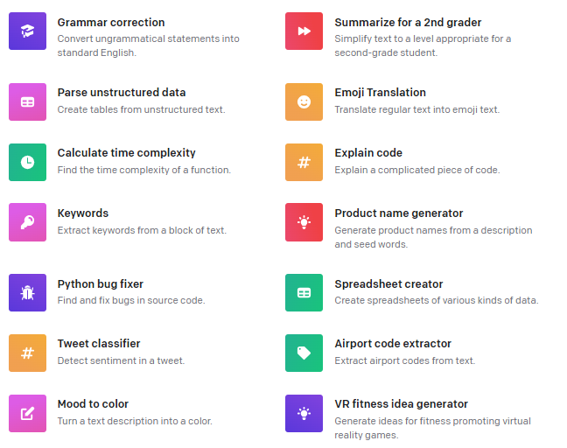
Potential Applications- OpenAI API
Prompt Engineering
https://platform.openai.com/examples
Notes:
Widely accepted definition.
Perforamnce is qunatitaive(Scalar , or vector) lets .8 , you get more experience E . You improve your performance let say .85, it mean you learn.
Experience is some thing gain by some entity and you can can direct that entity how to learn. This entity may be any algorithm, robot, software agent.
If b

Slide 5
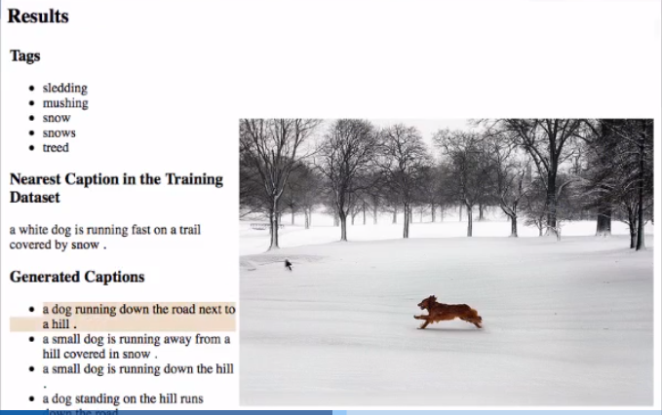
Image Tagging
Notes:
Widely accepted definition.
Perforamnce is qunatitaive(Scalar , or vector) lets .8 , you get more experience E . You improve your performance let say .85, it mean you learn.
Experience is some thing gain by some entity and you can can direct that entity how to learn. This entity may be any algorithm, robot, software agent.
If b

Slide 6
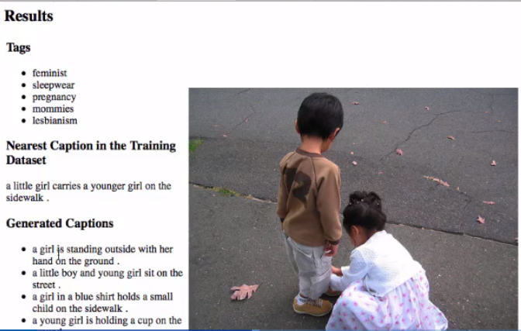
Image Tagging
Notes:
Widely accepted definition.
Perforamnce is qunatitaive(Scalar , or vector) lets .8 , you get more experience E . You improve your performance let say .85, it mean you learn.
Experience is some thing gain by some entity and you can can direct that entity how to learn. This entity may be any algorithm, robot, software agent.
If b

Slide 7
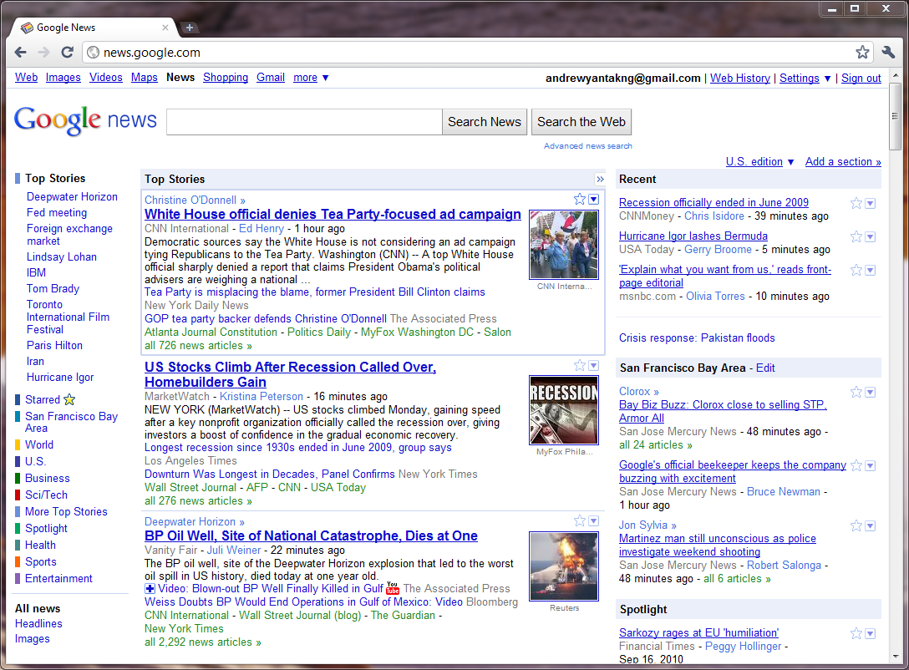
News Clustering

Slide 8
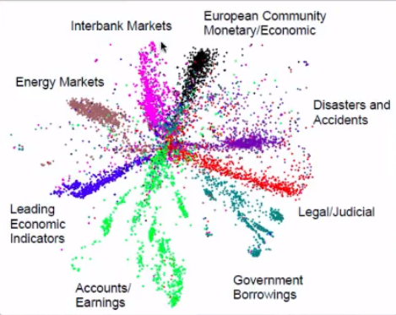
Market Segmentation
Notes:
Widely accepted definition.
Perforamnce is qunatitaive(Scalar , or vector) lets .8 , you get more experience E . You improve your performance let say .85, it mean you learn.
Experience is some thing gain by some entity and you can can direct that entity how to learn. This entity may be any algorithm, robot, software agent.
If b

Slide 9
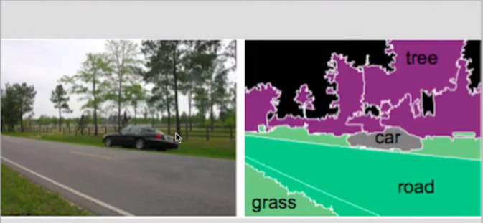
Image Detection and Localization
Notes:
Widely accepted definition.
Perforamnce is qunatitaive(Scalar , or vector) lets .8 , you get more experience E . You improve your performance let say .85, it mean you learn.
Experience is some thing gain by some entity and you can can direct that entity how to learn. This entity may be any algorithm, robot, software agent.
If b

Slide 10
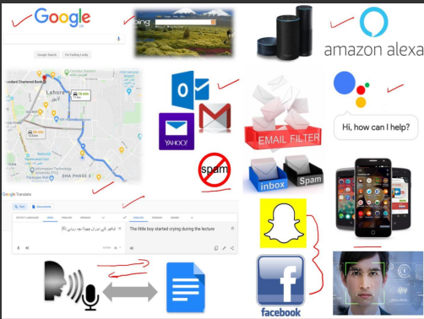
Daily used Applications
Notes:
Widely accepted definition.
Perforamnce is qunatitaive(Scalar , or vector) lets .8 , you get more experience E . You improve your performance let say .85, it mean you learn.
Experience is some thing gain by some entity and you can can direct that entity how to learn. This entity may be any algorithm, robot, software agent.
If b

Slide 11
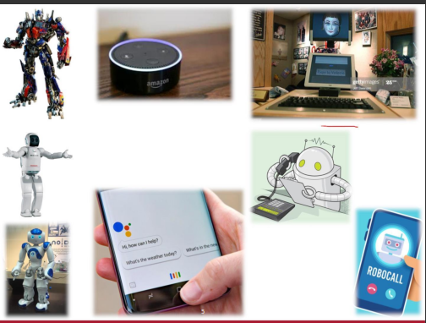
Daily used Applications

Slide 12
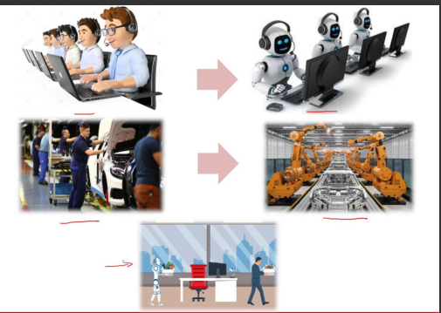
Daily used Applications

Slide 13
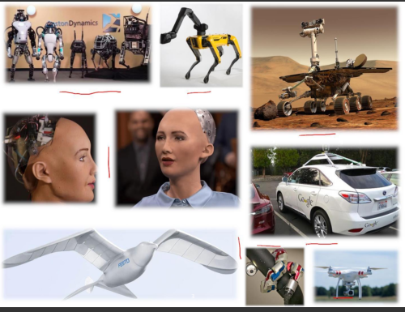
Applications

Slide 14
Historical Background
Early Foundations (1940s - 1950s):
Warren McCulloch and Walter Pitts: first neural networks, artificial neurons inspired by biological brains
AI Winter (1970s - 1980s):
faced significant challenges and a period known as the "AI Winter”
lack of funding and limited practical success
Reemergence (1990s):
resurgence in the 1990s, driven by advances in computing power and algorithmic improvements.
Decision trees, support vector machines
Rise of Deep Learning (2000s - Present):
deep neural networks, particularly deep convolutional neural networks (CNNs) for image recognition.
better optimization algorithms
availability of large datasets, like ImageNet,
increased computing power (GPUs)

Slide 15
Historical Background
Deep Learning's Dominance (2010s - Present):
dominant approach for mage and speech recognition, natural language processing, and reinforcement learning
recurrent neural networks (RNNs), long short-term memory networks (LSTMs), and Transformers
Frameworks like TensorFlow and PyTorch
Applications and Real-World Impact:
healthcare (diagnosis and drug discovery), autonomous vehicles, finance (algorithmic trading), and more.
Natural language processing models like GPT-3 and BERT
Future Directions (Beyond 2021):
evolve, with ongoing research into improving the efficiency, robustness, and generalization capabilities of deep learning models.
Exploring quantum computing's potential for machine learning and addressing ethical AI issues will be critical in the coming years.

Slide 16
Machine Learning Guru’s
Geoffrey Hinton: | affiliated with Google Brain as a Chief Scientific Advisor and a Professor Emeritus at the University of Toronto. Godfather of Deep Learning," Geoffrey Hinton made significant contributions to neural networks, backpropagation, and deep learning architectures, including Boltzmann Machines and the development of convolutional neural networks (CNNs).
Yann LeCun: | renowned for his work in convolutional neural networks (CNNs) and is a pioneer in the field of computer vision. He's also known for his contributions to the development of the backpropagation algorithm. Yann LeCun was a Chief AI Scientist at Facebook AI and a Professor at New York University (NYU).
Andrew Ng: | Professor at Stanford University and the co-founder of deeplearning.ai, an online learning platform. Andrew Ng is a co-founder of Google Brain and is known for his work on online education, including the creation of the popular machine learning course on Coursera. He has made significant contributions to the field of deep learning.

Slide 17
Machine Learning Guru’s
Fei-Fei Li: | is known for her work in computer vision and co-authored the ImageNet dataset, which played a pivotal role in the development of deep learning for image
Richard Sutton: | Richard Sutton is a prominent figure in reinforcement learning. His work includes the development of the temporal difference learning algorithm and his
Ian Goodfellow: | Ian Goodfellow is the author of the widely used textbook "Deep Learning." He's known for his work on generative adversarial networks (GANs) and has made significant contributions to deep learning research.

Slide 18
Programming Languages
Python:
most popular programming language for machine learning and deep learning due to its extensive libraries (NumPy, SciPy, pandas) and the availability of frameworks like TensorFlow and PyTorch.
R:
R often used in statistical modeling and data analysis. It has a rich ecosystem of packages for machine learning
Julia:
an emerging programming language known for its speed and is increasingly being used in scientific computing and machine learning.

Slide 19
Programming Languages
JavaScript:
JavaScript is used for implementing machine learning models in web applications and browser-based AI.
MATLAB:
MATLAB is used in academic and research settings for machine learning and signal processing applications.

Slide 20
Frameworks/API’s for Machine Learning
TensorFlow:
Developed by Google, TensorFlow is one of the most widely used deep learning frameworks. It offers a high level of flexibility and supports both CPU and GPU computations.
PyTorch:
PyTorch, developed by Facebook's AI Research lab (FAIR), is known for its dynamic computational graph and is favored by researchers for its ease of use and flexibility.
Keras:
Keras is a high-level neural networks API that can run on top of TensorFlow, Theano, or Microsoft Cognitive Toolkit (CNTK). It's known for its user-friendly interface.
Scikit-learn:
Scikit-learn is a popular machine learning library for Python, providing tools for classical machine learning algorithms and data preprocessing.

Slide 21
Frameworks/API’s for Machine Learning
Caffe:
Caffe is a deep learning framework developed by the Berkeley Vision and Learning Center. It's known for its speed and efficiency in image classification tasks.
MXNet:
MXNet is an open-source deep learning framework known for its scalability and support for multiple programming languages, including Python and Julia.
Theano:
Although its development has slowed down, Theano was influential in the early days of deep learning and served as a precursor to other frameworks.
Caffe2:
Developed by Facebook, Caffe2 was designed for mobile and large-scale distributed training and has been integrated into PyTorch as part of the PyTorch 1.0 release.

Slide 22
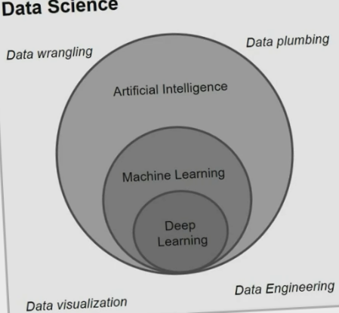
Demystifying DS,AI, ML and DL
Notes:
Widely accepted definition.
Perforamnce is qunatitaive(Scalar , or vector) lets .8 , you get more experience E . You improve your performance let say .85, it mean you learn.
Experience is some thing gain by some entity and you can can direct that entity how to learn. This entity may be any algorithm, robot, software agent.
If b
Deep learning liberaries: Theano, panda, keras, scikt-Learn,pandas

Slide 23
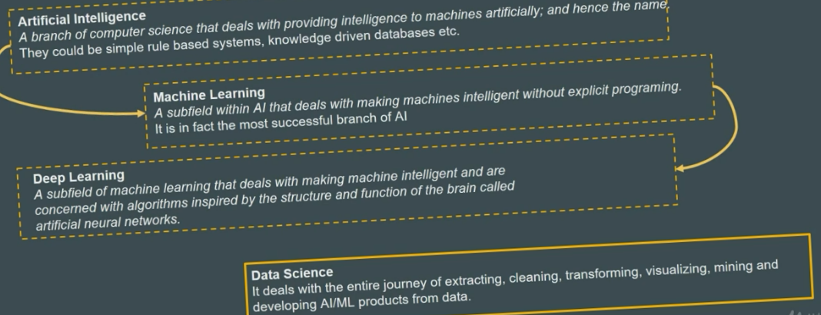

Slide 24
Machine Learning Definition
Philosophical learning of meaning
Tom Michel Definition ML as
A computer is said to be Learn from experience E with respect to some task T and some performance measure P, if its performance on T, as measured by P, improve with Experience E.

Slide 25
Notation
Variable
Random Variable
Vector
Notes:
Standard notations
You know the latin symbole after ABC like sigma, gemma,
e.g. number 2 and put in a variable x
In ml x is a constant which has some value but we dnt know
An other thing opposite to it
X belongs to real number
Random variable
Like a variable in language we know the chance what chance of the value.
White board length and width 10* 5
Y belong to R square
Length and witdht and grayscale shade
10,5, 0.8

Slide 26
Diving into Machine Learning with Jupyter
Notes:
Widely accepted definition.
Perforamnce is qunatitaive(Scalar , or vector) lets .8 , you get more experience E . You improve your performance let say .85, it mean you learn.
Experience is some thing gain by some entity and you can can direct that entity how to learn. This entity may be any algorithm, robot, software agent.
If b

Slide 27
Domains of Machine Learning
Supervised Learning
Like Teach , Supervisor
Human knows the ground truth
Regression
Classification
Unsupervised Learning
Clustering
Auto-encoder
Dimensionality Reduction
Reinforcement Learning
Notes:
Three types of learning
Like a teacher , supervisiosr , you tell him

Slide 28
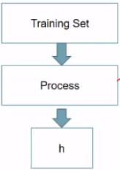
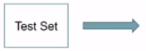
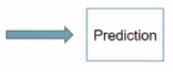
Linear Regression
Notes:
Three types of learning
Like a teacher , supervisiosr , you tell him

Slide 29
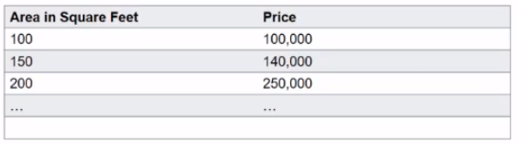
Linear Regression
Example:
Notation:
x’s = “input” variable / features
m = Number of training examples
y’s = “output” variable / “target” variable
Notes:
Three types of learning
Like a teacher , supervisiosr , you tell him

Slide 30
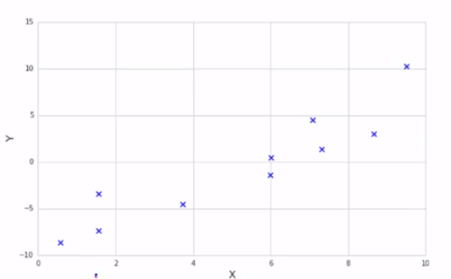
Plot/Shape-up Data
Example:
Notes:
Three types of learning
Like a teacher , supervisiosr , you tell him

Slide 31
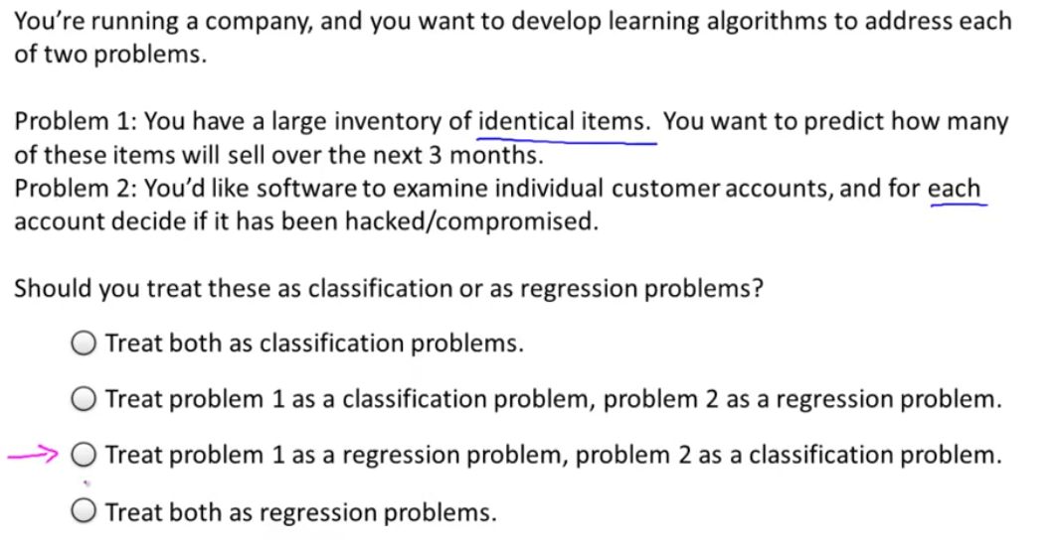
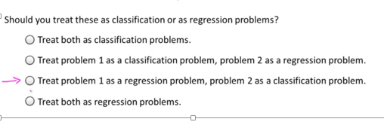

Slide 32
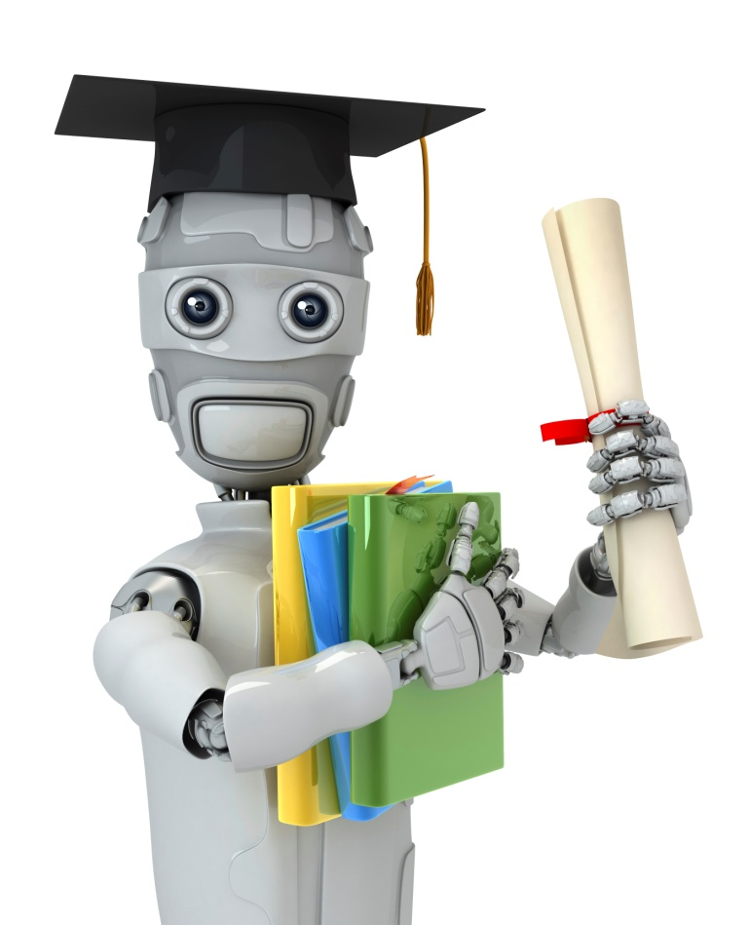
Unsupervised Learning
Introduction
Machine Learning
Notes:
Unsupervised learning, on the other hand, allows us to approach problems with little or no idea what our results should
look like. We can derive structure from data where we don't necessarily know the effect of the variables.
We can derive this structure by clustering the data based on relationships among the variables in the data.
With unsupervised learning there is no feedback based on the prediction results, i.e., there is no teacher to correct you.
Example:
Clustering: Take a collection of 1000 essays written on the US Economy, and nd a way to automatically group these
essays into a small number that are somehow similar or related by dierent variables, such as word frequency, sentence
length, page count, and so on.
Non-clustering: The "Cocktail Party Algorithm", which can nd structure in messy data (such as the identication of
individual voices and music from a mesh of sounds at a cocktail party (https://en.wikipedia.org/wiki/Cocktail_party_eect)
). Here is an answer on Quora to enhance your understanding. : https://www.quora.com/What-is-the-dierence-betweensupervised-and-unsupervised-learning-algorithms
?

Slide 33
UnSupervised Learning
x₂
x₁
Notes:
In unsupervised learning there is no labeled data
We are not told what to do.

Slide 34
Unsupervised Learning
x₂
x₁

Slide 35
Notes:
One example is use clustering in google news
Goes to news.google.com
Automatically cluster the relevant stories

Slide 36
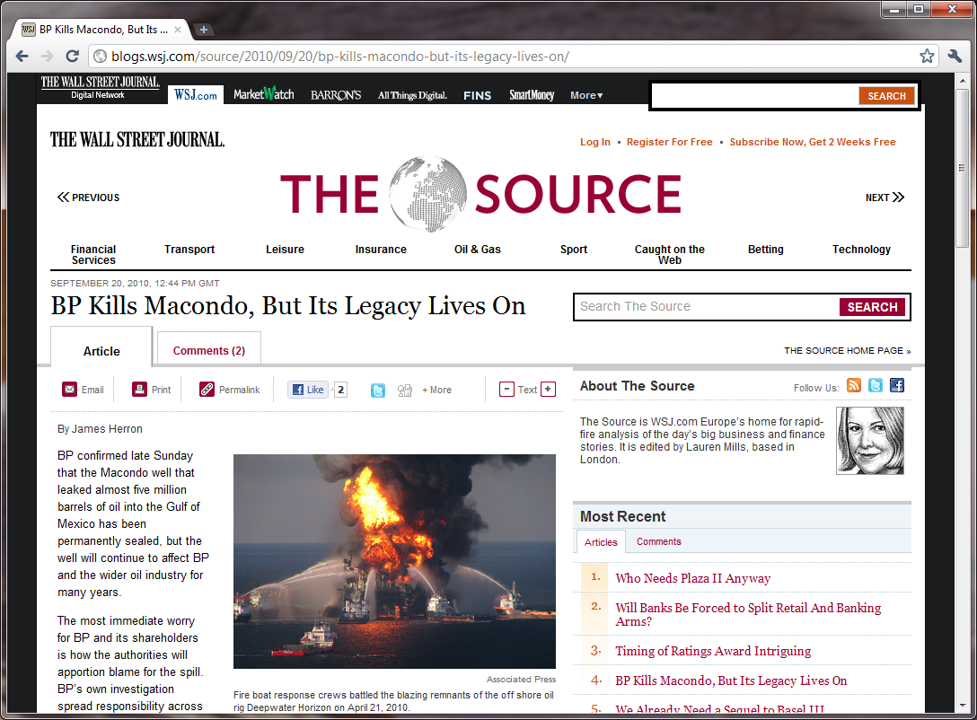

Slide 37
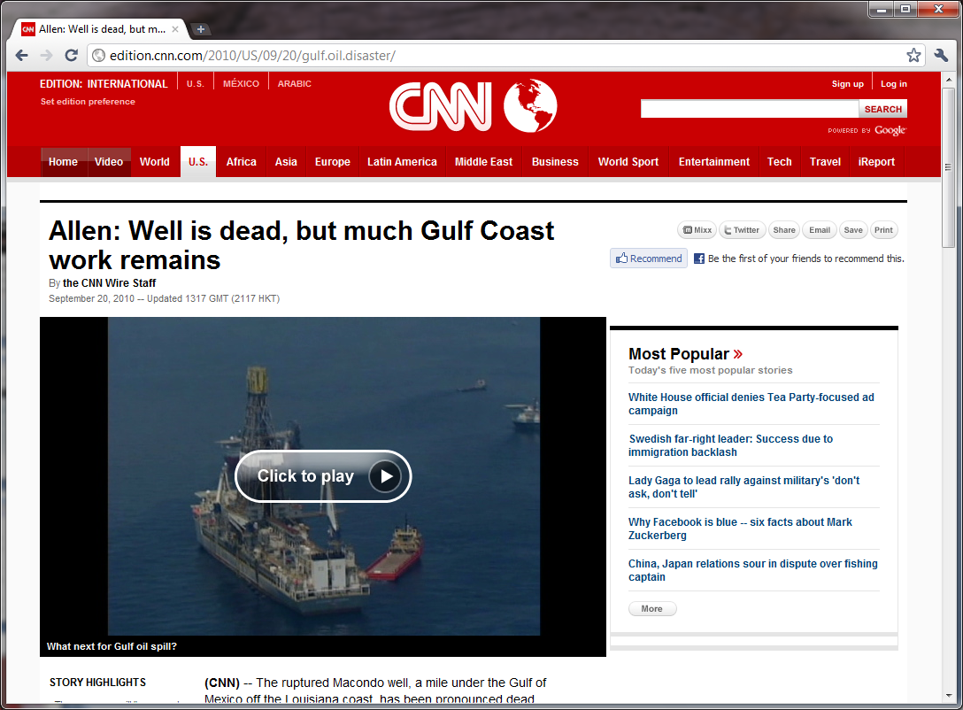

Slide 38
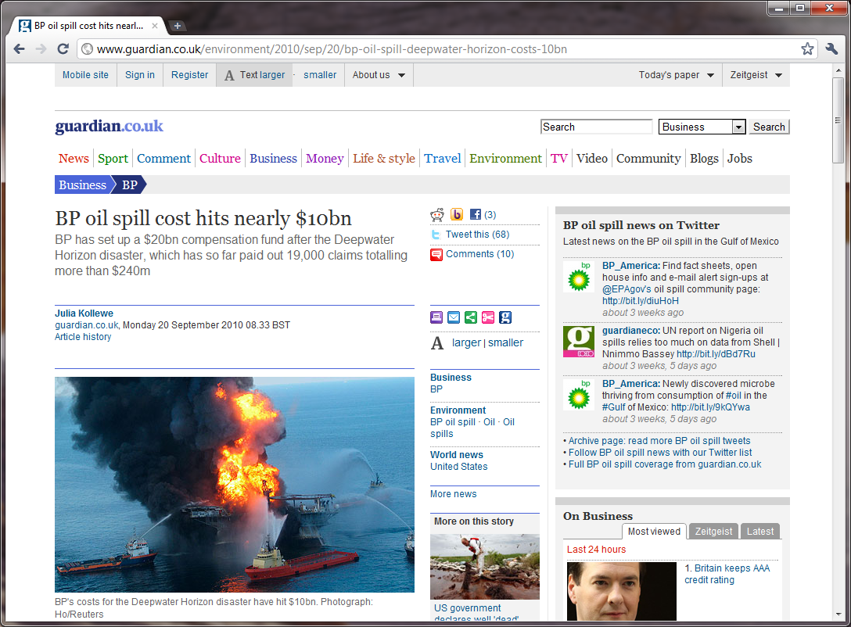

Slide 39
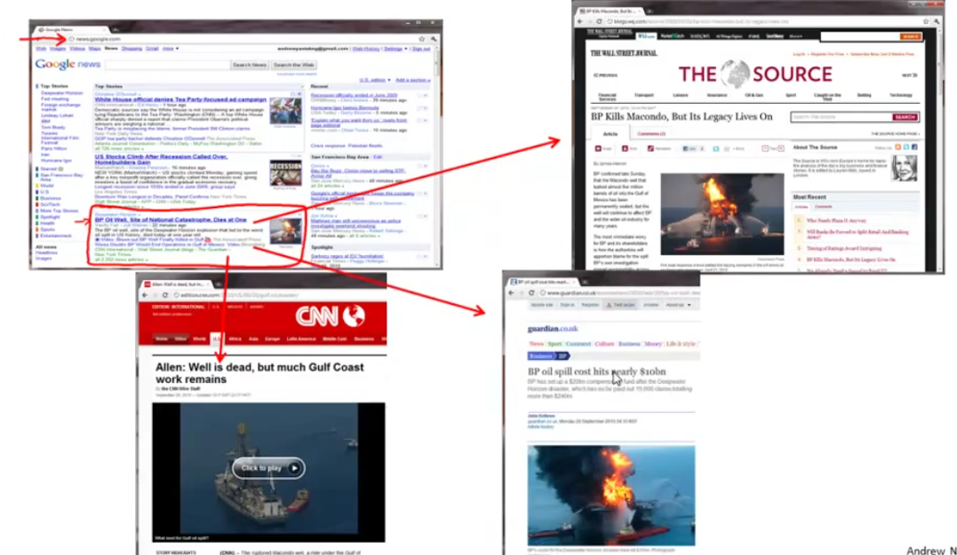

Slide 40
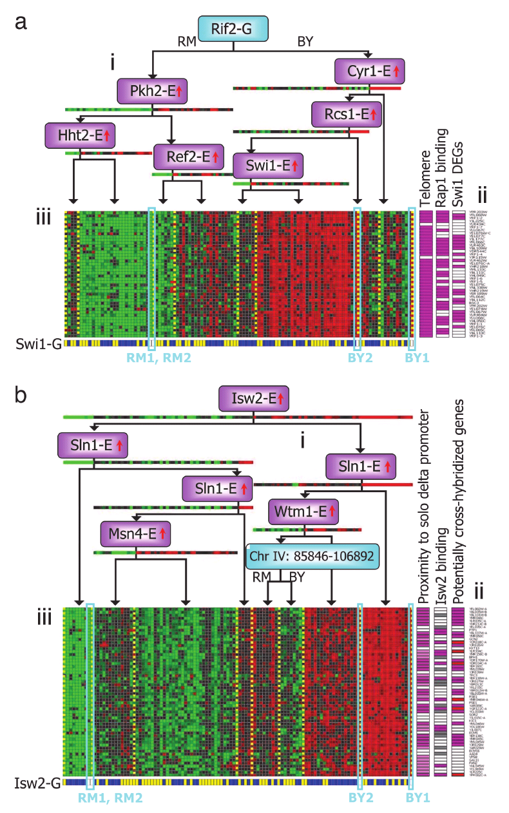
Genes
Individuals
[Source: Su-In Lee, Dana Pe’er, Aimee Dudley, George Church, Daphne Koller]
Notes:
Other example is of genomix
DNA micro ray data
How much a certain have gene
Color red green and so on show a person have a specific gene or not
We run the clustering algo to groupe the person into different catagories , this is unsupervised learning
This may tell the type of the person typ1 type 2

Slide 41

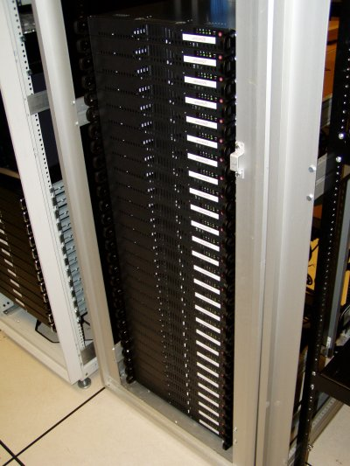
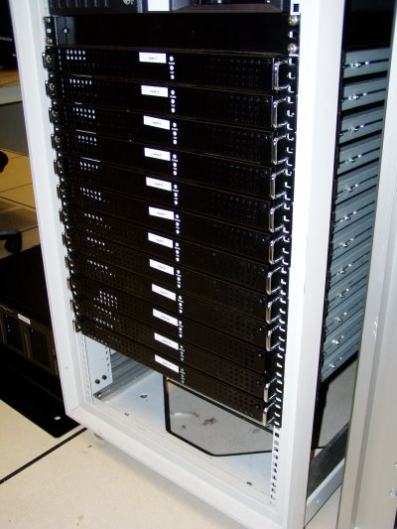

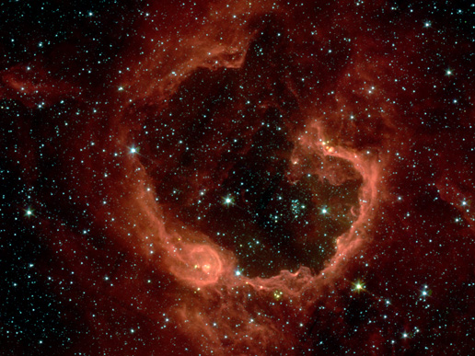
Organize computing clusters
Social network analysis
Market segmentation
Image credit: NASA/JPL-Caltech/E. Churchwell (Univ. of Wisconsin, Madison)
Astronomical data analysis
Notes:
Unsupervised/clustering is used in much applications. Is also used to organized large computer clusters
you may make the data center on the base of usage of the data , or trafic
Astronomical data analysis image obtained from NASA website.
http://www.nasa.gov/multimedia/imagegallery/image_feature_874.html
RCW 79 is seen in the southern Milky Way, 17,200 light-years from Earth in the constellation Centaurus. The bubble is 70-light years in diameter, and probably took about one million years to form from the radiation and winds of hot young stars. The balloon of gas and dust is an example of stimulated star formation. Such stars are born when the hot bubble expands into the interstellar gas and dust around it. RCW 79 has spawned at least two groups of new stars along the edge of the large bubble. Some are visible inside the small bubble in the lower left corner. Another group of baby stars appears near the opening at the top. NASA's Spitzer Space Telescope easily detects infrared light from the dust particles in RCW 79. The young stars within RCW79 radiate ultraviolet light that excites molecules of dust within the bubble. This causes the dust grains to emit infrared light that is detected by Spitzer and seen here as the extended red features.
Cohesive group of friends
Huge database of customer information can be used for customer segmentation. E.g sell better
These are unsupervisor we dnt know in advance who is in much segement
used in astronomical data analysis to cluster the galaxies how they are formed. Image credit: NASA/JPL-Caltech/E. Churchwell (Univ. of Wisconsin, Madison)
--------------------
From
NASA use guidelines:
http://www.nasa.gov/multimedia/guidelines/index.html
Using NASA Imagery and Linking to NASA Web Sites 10.13.05 Still Images, Audio Files and Video
NASA still images, audio files and video generally are not copyrighted. You may use NASA imagery, video and audio material for educational or informational purposes, including photo collections, textbooks, public exhibits and Internet Web pages. This general permission extends to personal Web pages.
This general permission does not extend to use of the NASA insignia logo (the blue "meatball" insignia), the retired NASA logotype (the red "worm" logo) and the NASA seal. These images may not be used by persons who are not NASA employees or on products (including Web pages) that are not NASA sponsored.
If the NASA material is to be used for commercial purposes, especially including advertisements, it must not explicitly or implicitly convey NASA's endorsement of commercial goods or services. If a NASA image includes an identifiable person, using the image for commercial purposes may infringe that person's right of privacy or publicity, and permission should be obtained from the person. Any questions regarding application of any NASA image or emblem should be directed to:
Photo Department NASA Headquarters 300 E St. SW Washington, DC 20546 Tel: (202)358-1900 Fax: (202)358-4333
Linking to NASA Web Sites
NASA Web sites are not copyrighted, and may be linked to from other Web sites, including individuals' personal Web sites, without explicit permission from NASA. However, such links may not explicitly or implicitly convey NASA's endorsement of commercial goods or services.
NASA images may be used as graphic "hot links" to NASA Web sites, provided they are used within the guidelines above. This permission does not extend to use of the NASA insignia, the retired NASA logotype or the NASA seal.
Restrictions
Please be advised that:
1) NASA does not endorse or sponsor any commercial product, service, or activity.
2) The use of the NASA name, initials, any NASA emblems (including the NASA insignia, the NASA logo and the NASA seal) which would express or imply such endorsement or sponsorship is strictly prohibited.
3) Use of the NASA name or initials as an identifying symbol by organizations other than NASA (such as on foods, packaging, containers, signs, or any promotional material) is prohibited.
4) NASA does permit the use of the NASA logo and insignia on novelty and souvenir-type items. However, such items may be sold and manufactured only after a proposal has been submitted to and approved by a Visual Identity representative from the Public Outreach Division (Phone: 202/358-1750) in accordance with 14 CFR (Code of Federal Regulations) Part 1221. Permission is granted on a nonexclusive basis as it is not NASA's policy to grant exclusive rights to use any of the agency identities.
5) No approval for use is authorized by NASA when the use can be construed as an endorsement by NASA of a product, service or activity.
6) NASA emblems should be reproduced only from original reproduction proofs, transparencies, or computer files available from NASA Headquarters. Please be advised that approval must be granted by a Visual Identity representative from the Public Outreach Division ( Tel: 202/358-1750) before any reproduction materials can be obtained.

Slide 42
Following examples, which would you address using an unsupervised learning algorithm? (Check all that apply.)
Given email labeled as spam/not spam, learn a spam filter.
Given a set of news articles found on the web, group them into set of articles about the same story.
Given a database of customer data, automatically discover market segments and group customers into different market segments.
Given a dataset of patients diagnosed as either having diabetes or not, learn to classify new patients as having diabetes or not.
Notes:
1 and 4 are suerpvised
23 are unsupervised

Slide 43
THANKS

